Slide 3
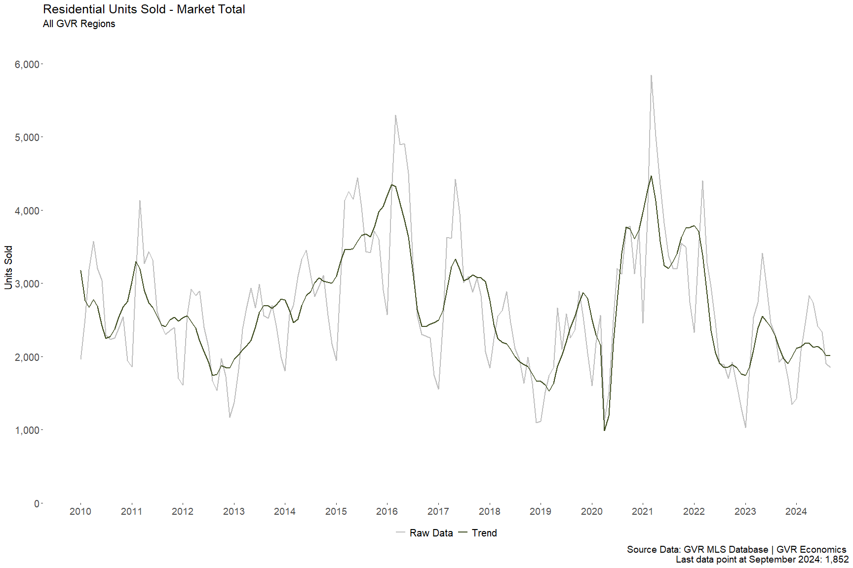

Slide 4
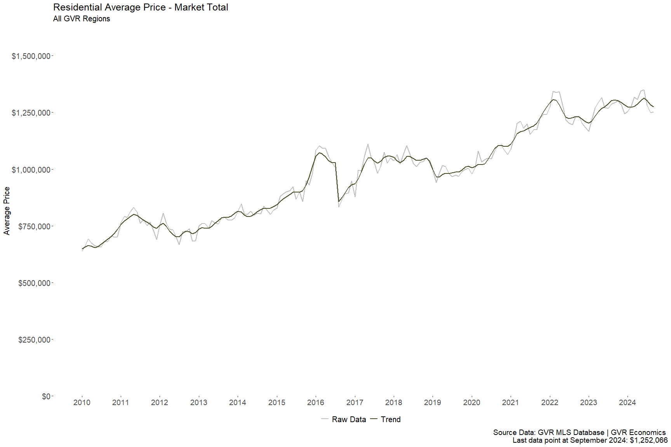

Slide 5
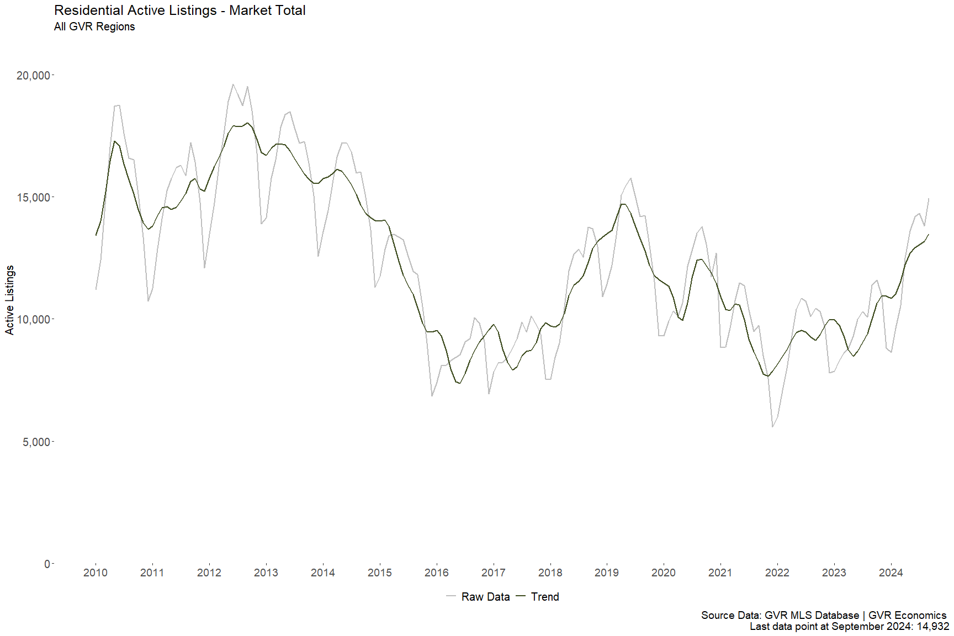

Slide 6
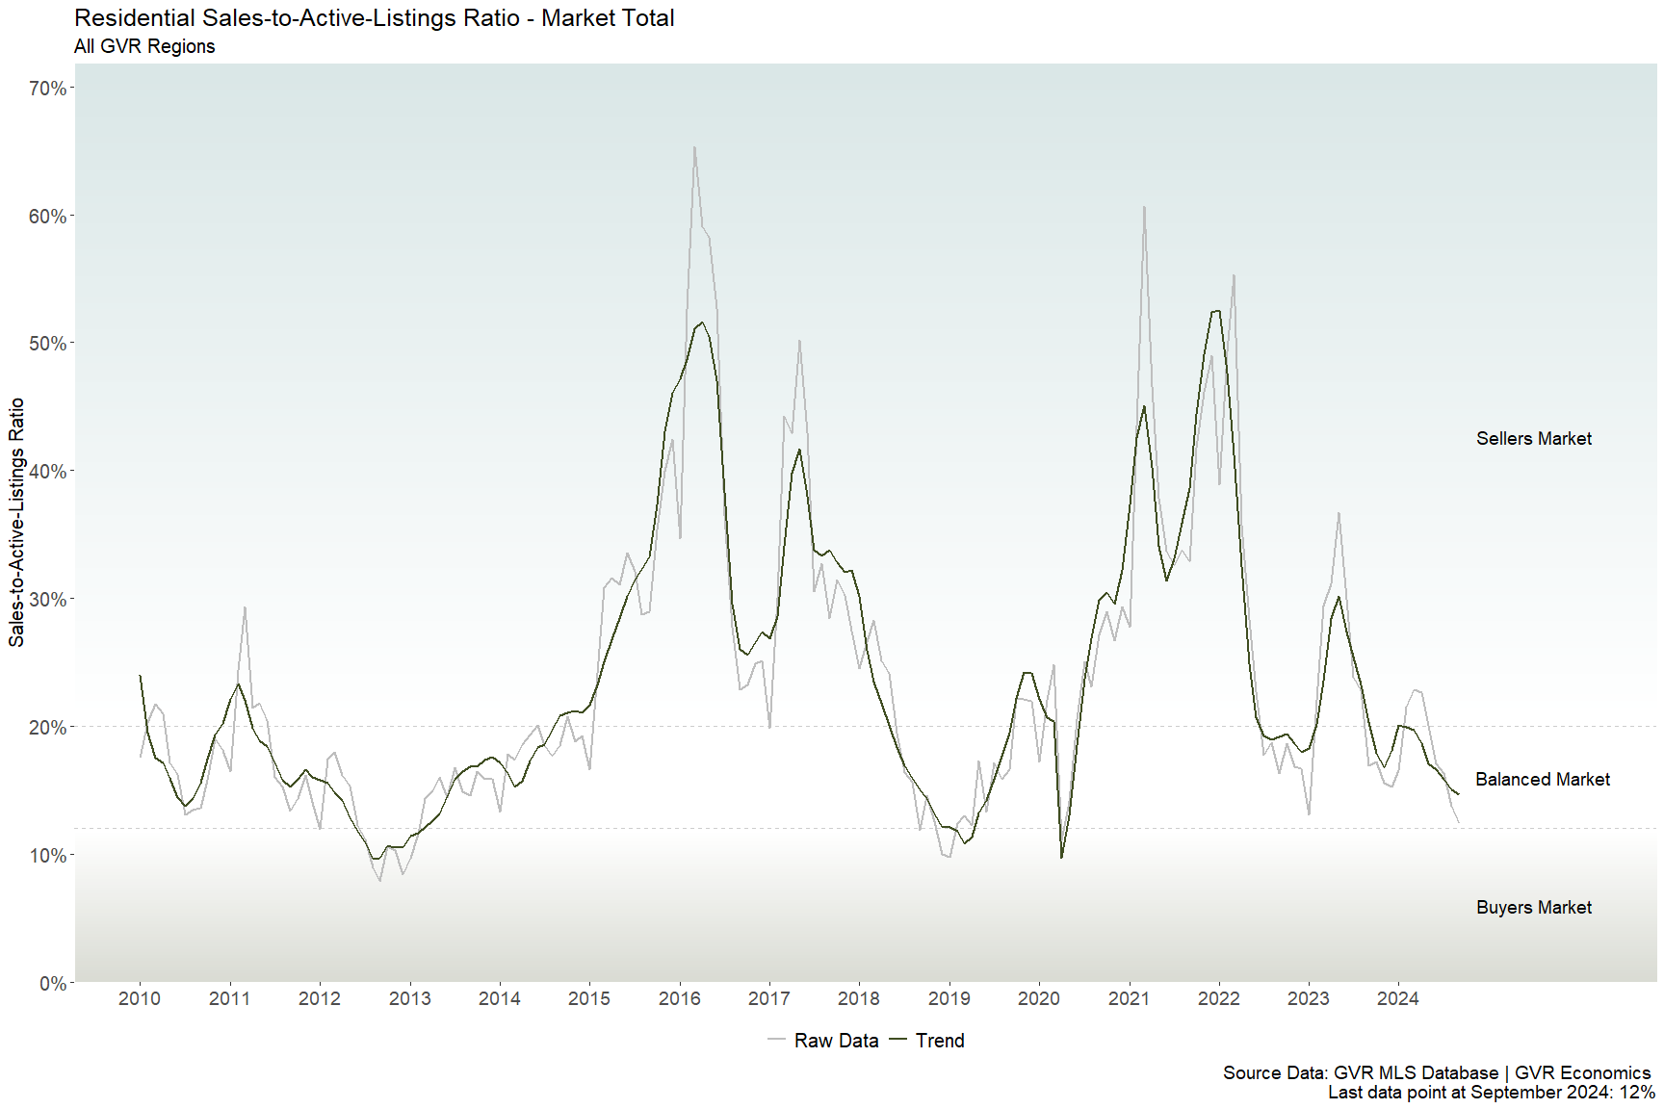

Slide 8
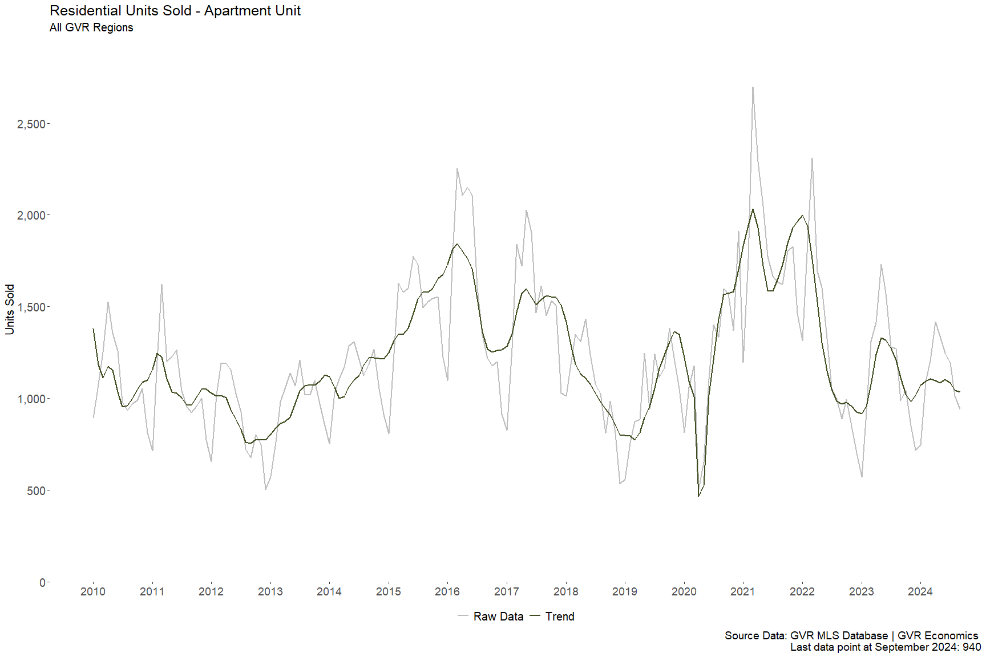

Slide 9
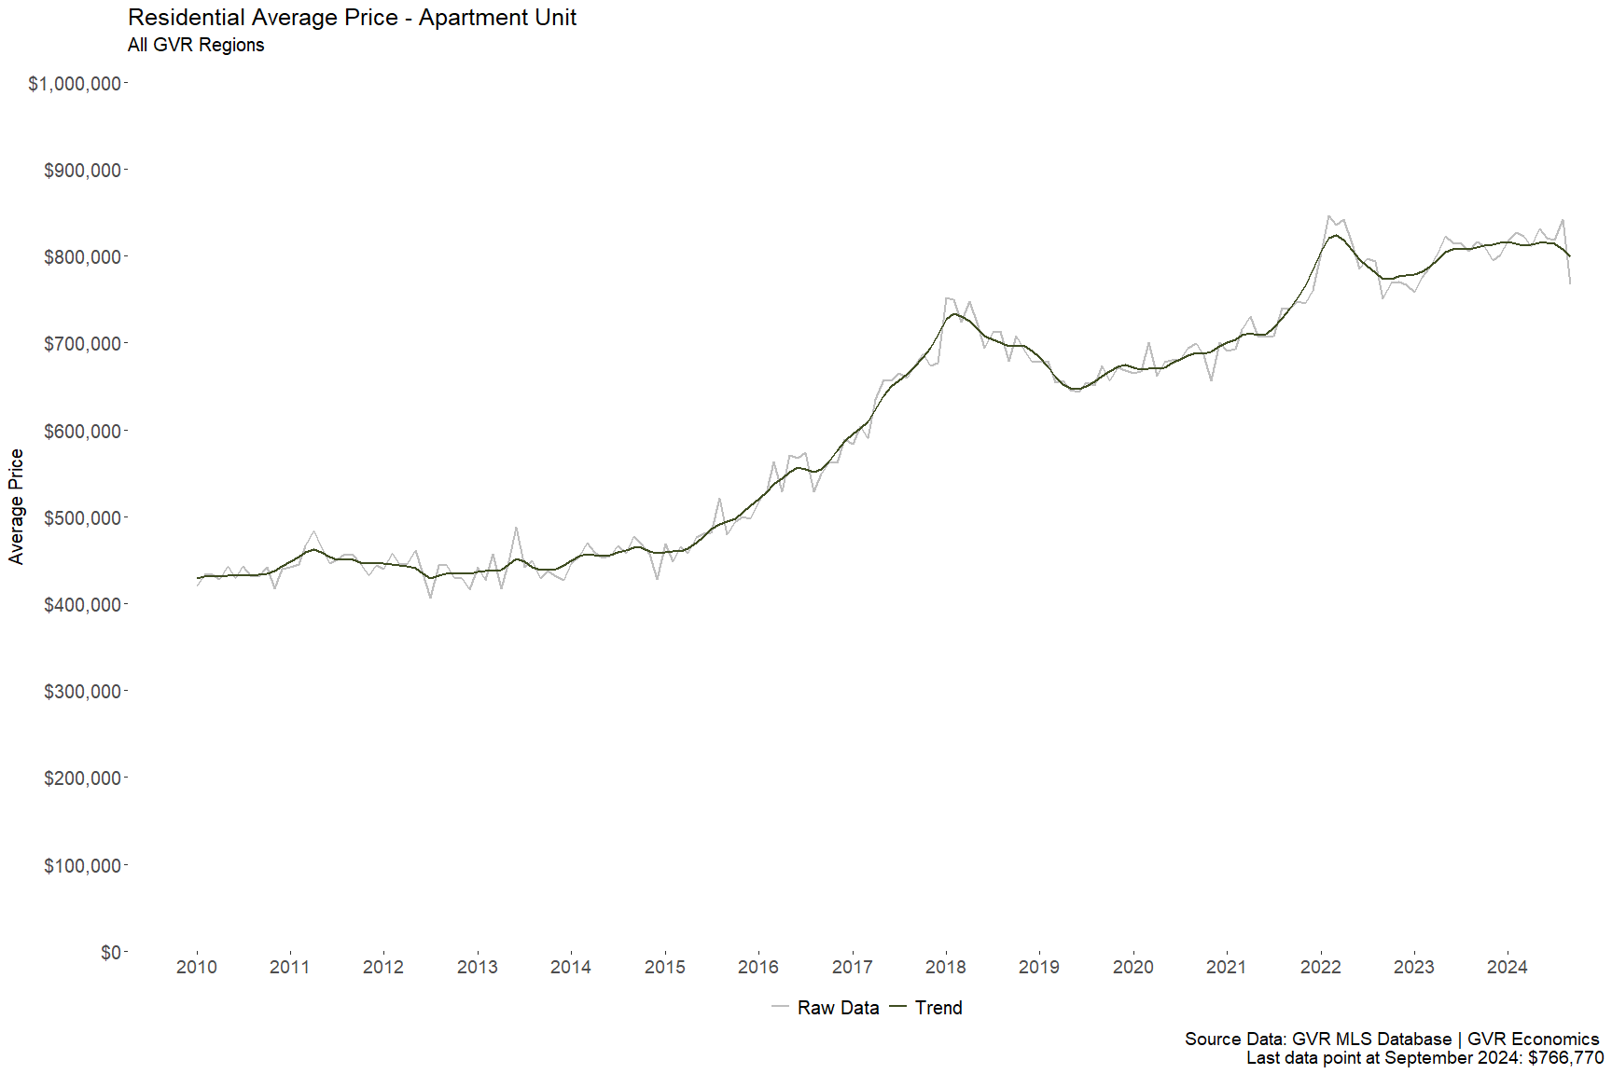

Slide 10
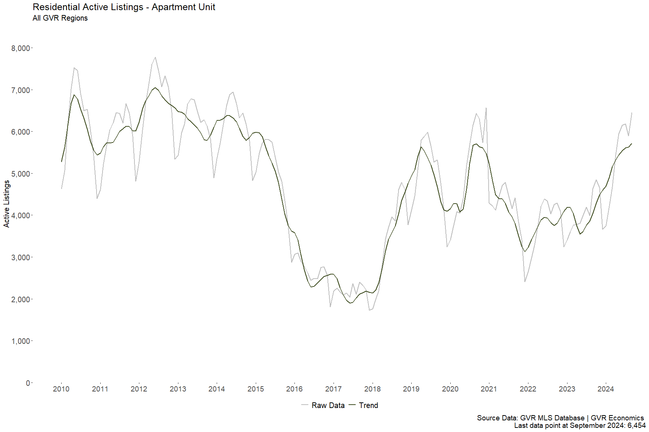

Slide 11
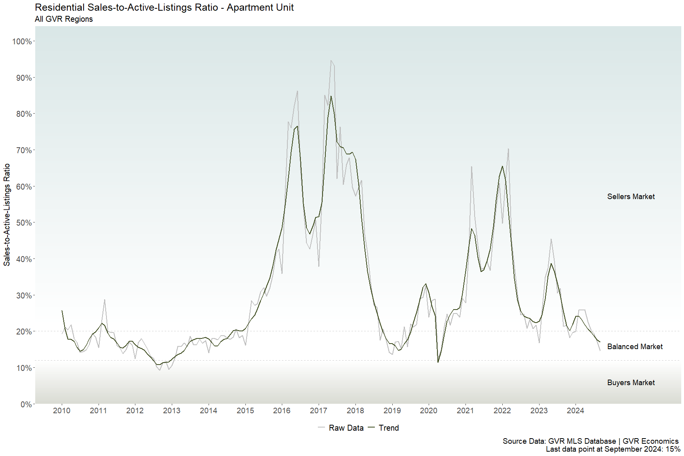

Slide 13
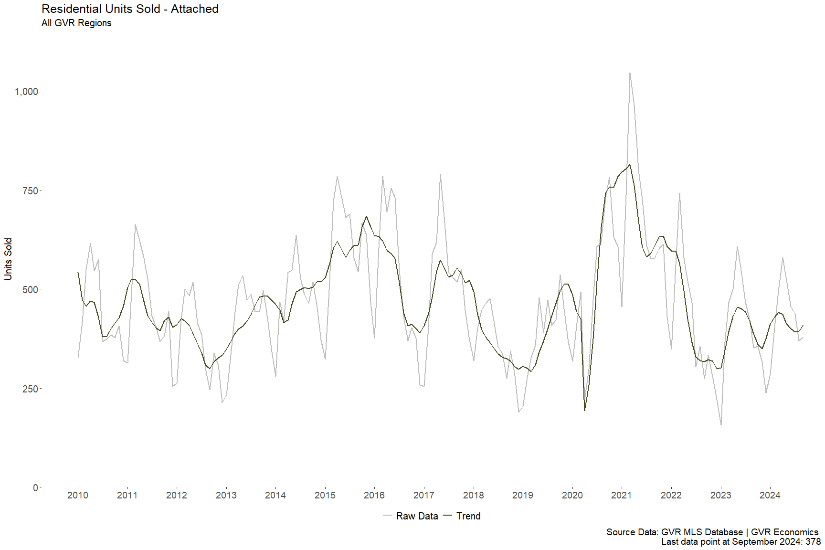

Slide 14
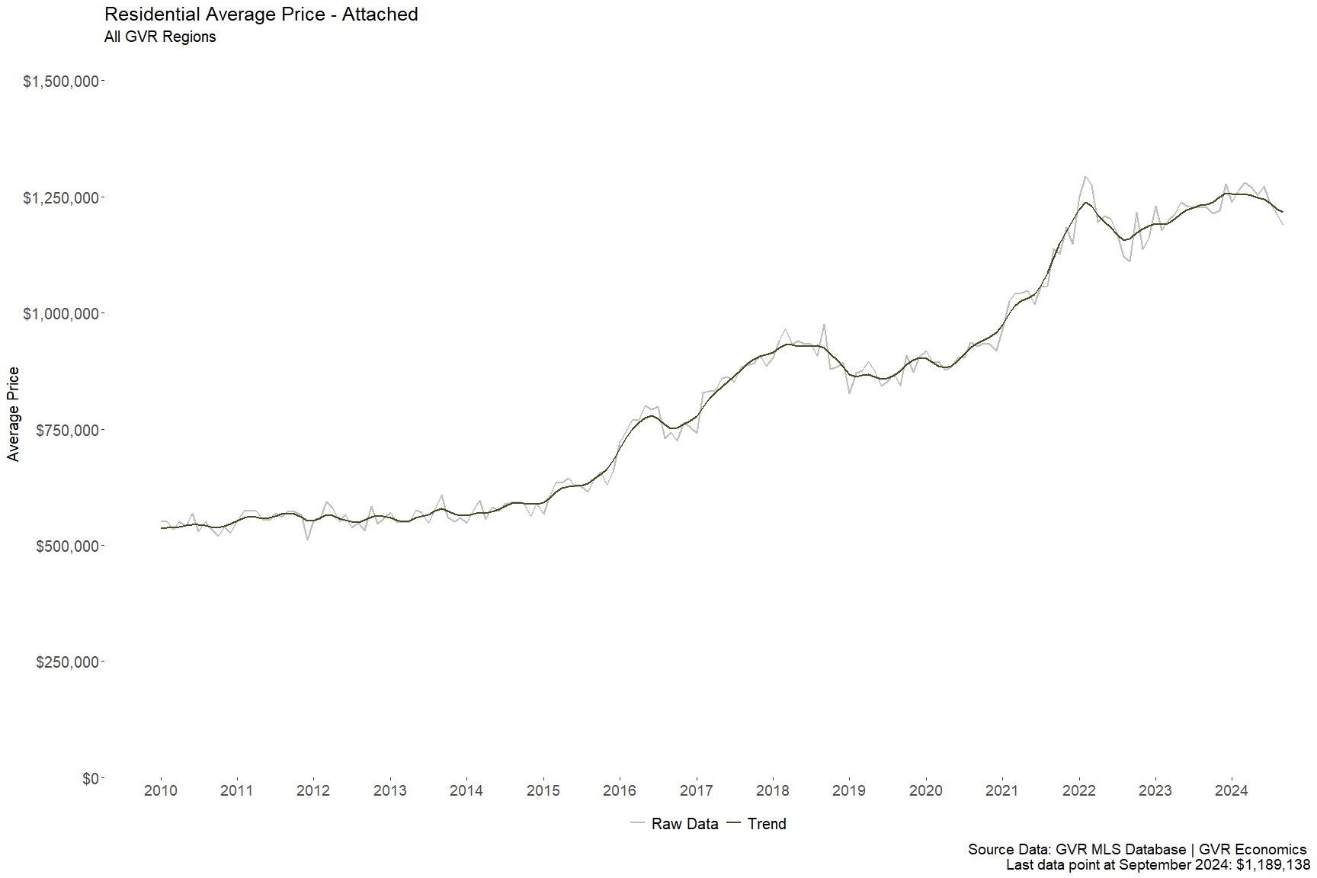

Slide 15
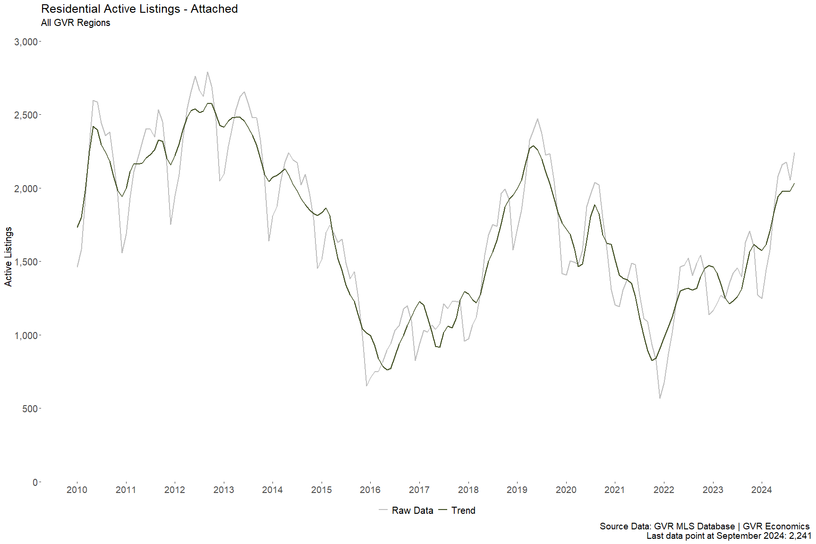

Slide 16
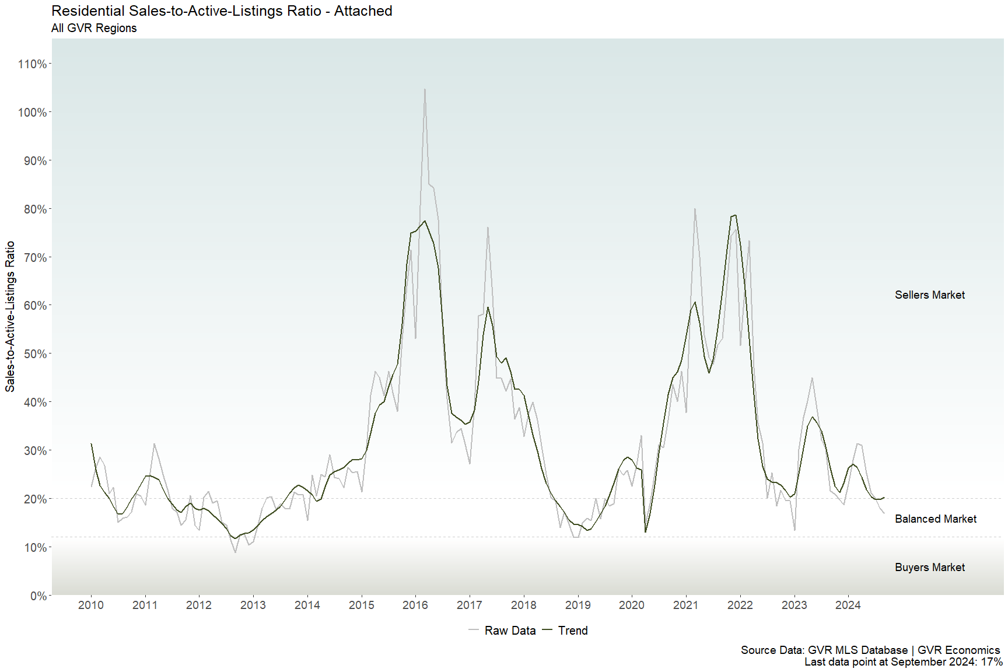

Slide 18
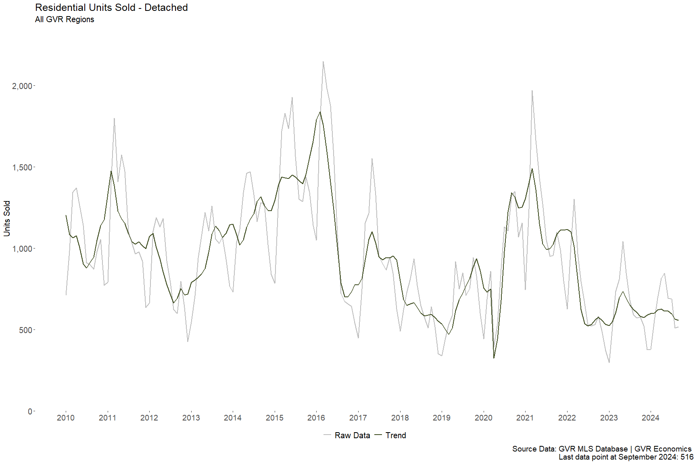

Slide 19
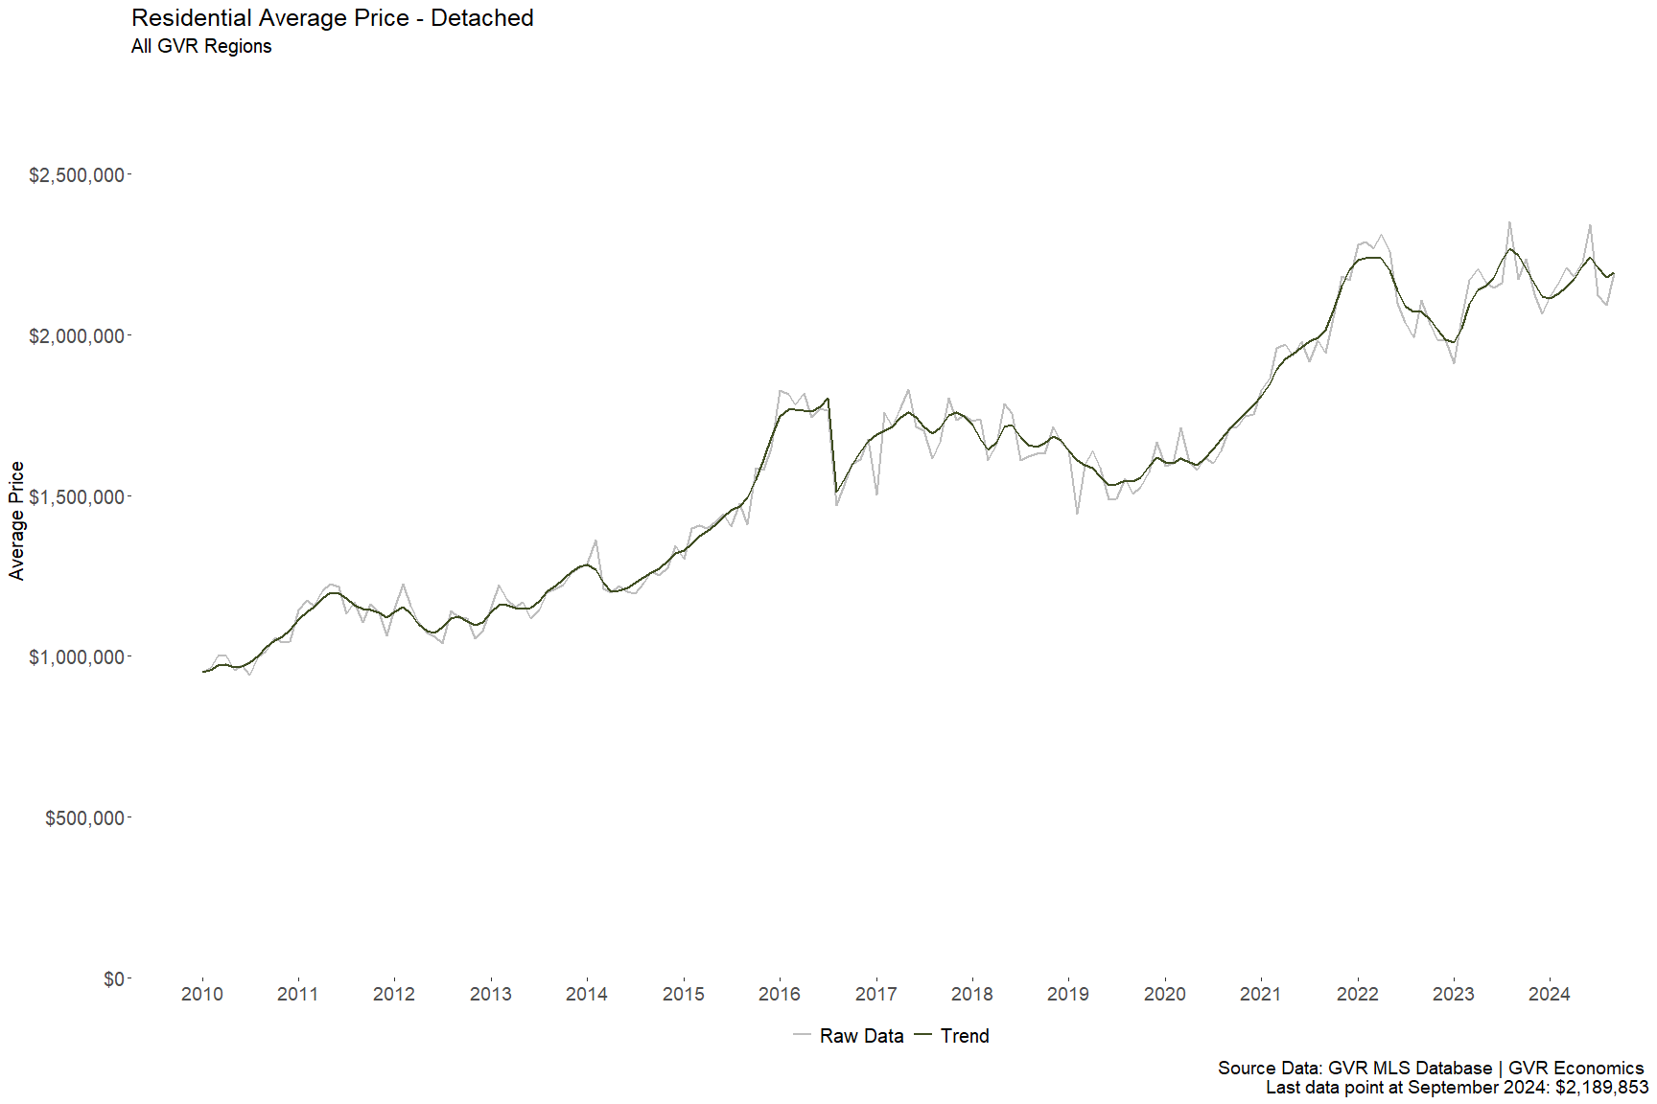

Slide 20
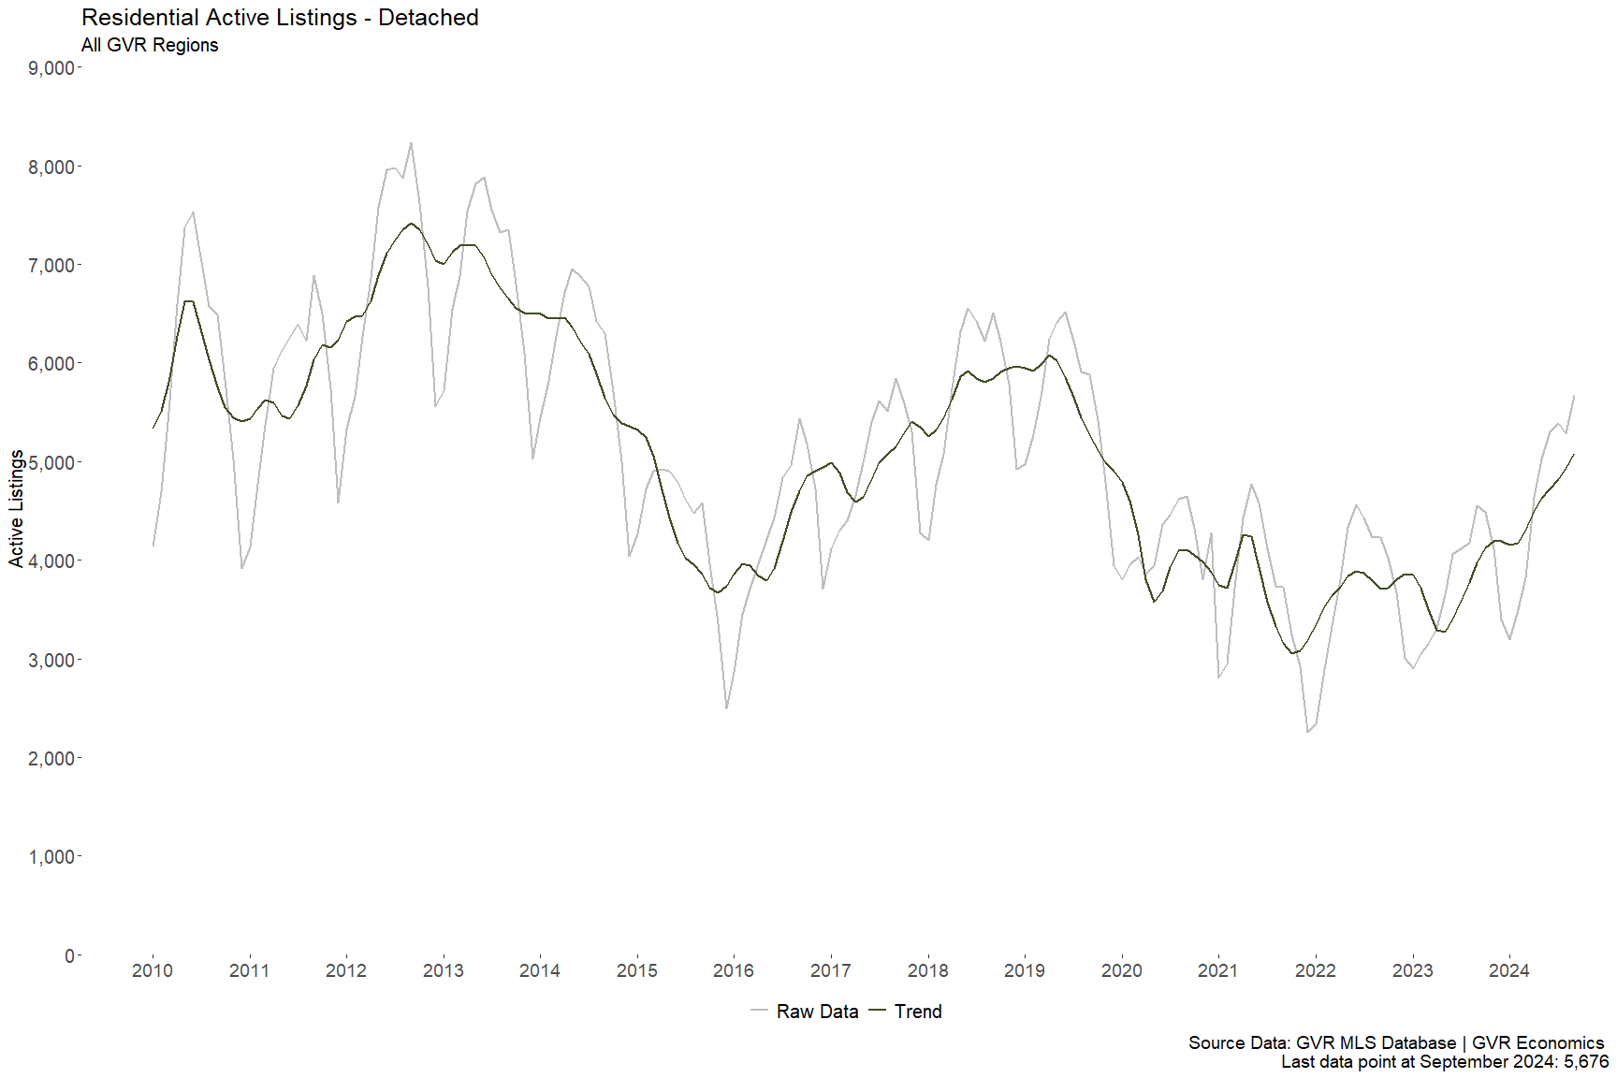

Slide 21
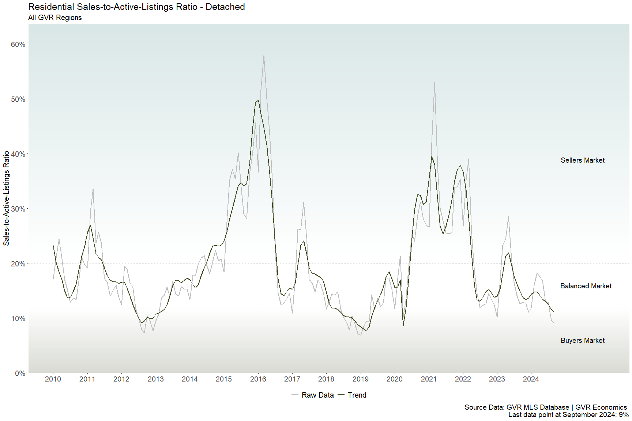

Slide 22
Appendix
Important terms and definitions:
Property Types
Apartment Unit: A residential unit that is typically a part of a larger multifamily residential building. Ownership of grounds and amenities are often part of a common ownership structure such as a strata.
Attached: A residential unit that is typically a part of a ground-oriented multifamily residential complex (e.g. townhouse), or a unit that shares a common wall with an adjoining unit, such as a duplex, triplex, etc.
Detached: A residential unit that typically does not share any common walls with adjoining units and where the land is not part of a common ownership structure such as a strata. These are most commonly represented in the data as “single-detached homes”.
Market Total: The sum of residential attached, apartment unit, detached, multi-family, and vacant land listings on the MLS® system. Please note multi-family and vacant land properties are not plotted in ChartBook as these typologies typically represent a small number of transactions in any given month. Because these property types do represent valid sales and inventory of residential properties on the MLS® system, they are included in the market totals for completeness.
Statistics
Raw Data: These are the unadjusted month-end figures for the variables described in detail below.
Trend: The trend component is generated from applying the X13 ARIMA SEATS seasonal adjustment model to the raw (unadjusted) data.
Variables
Units Sold: The month-end total number of residential properties sold on the MLS® system.
Average Price: This is a raw average, calculated by dividing the total month-end dollar volume of residential sales by the total month-end number of residential units sold.
Active Listings: The month-end total number of residential properties listed for sale on the MLS® system.
Sales-to-Active-Listings Ratio (SALR): The SALR is calculated as the ratio of the month-end total number of residential properties sold divided by the month-end total number of residential properties listed for sale on the MLS® system. It is often used as a measure of market balance, relating available supply to current demand. See definitions of market balance below for more details.

Slide 23
Market Balance
Buyers Market: When the sales-to-active-listings ratio (SALR) is 12 per cent or lower, this indicates the pace of sales is low relative to the stock of available inventory (i.e. active listings). This situation may be advantageous for buyers, as ample supply and low demand tilts negotiating power in favour of purchasers. Analysis of historical data suggests downward pressure on home prices occurs when the ratio remains below 12 per cent for a sustained period.
Sellers Market: When the SALR is 20 per cent or higher, this indicates the pace of sales is high relative to the stock of available inventory. This situation may be advantageous for sellers, as low supply and high demand tilts negotiating power in favour of sellers. Analysis of historical data suggests upward pressure on home prices occurs when the ratio remains above 20 per cent for a sustained period.
Balanced Market: When the SALR is between 12 and 20 per cent, this indicates the pace of sales is balanced relative to the stock of available inventory. This situation is often beneficial for sellers and buyers, as both parties can exert some degree of negotiating power and are often afforded more time to carry out due diligence. Analysis of historical data suggests home prices remain stable when the ratio remains between 12 and 20 per cent for a sustained period.
Geographical Coverage
Areas covered by Greater Vancouver REALTORS® include: Bowen Island, Burnaby, Coquitlam, Maple Ridge, New Westminster, North Vancouver, Pitt Meadows, Port Coquitlam, Port Moody, Richmond, South Delta, Squamish, Sunshine Coast, Vancouver, West Vancouver, and Whistler.
The data displayed in ChartBook are aggregations across all of the listed regions.

